Slide 1
Group 3:
Alternative Vehicles Analysis
Adam Armagost, Beverly “Scout” Phillip, Di. Gibson, Julia Cheng, Hazel Morris, Rashaye Harris

Slide 2
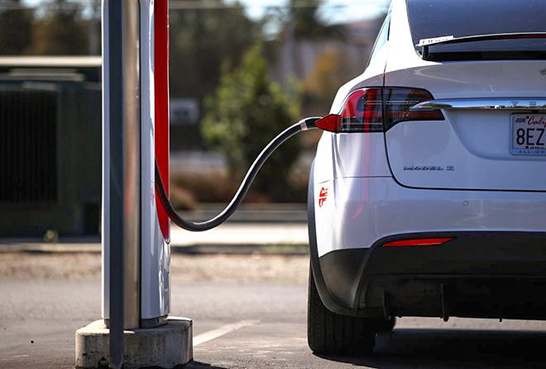
Purpose
Original Question -
“Does driving an Electric Vehicle have a positive impact on the environment? “
Goal -
The group goal was to explore the correlation between alternative vehicle registrations in the state of California and identify if the the increase in registrations correlates to less impact on carbon emissions.

Slide 3


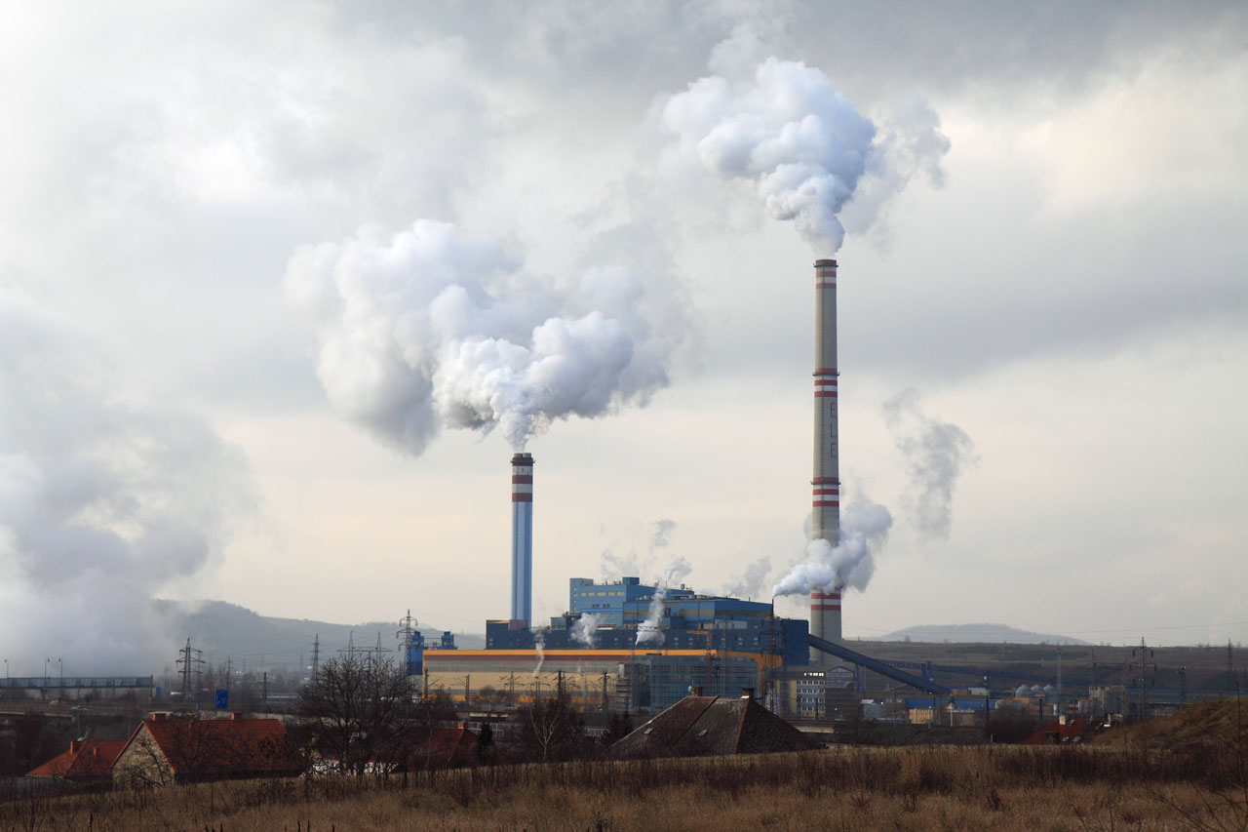


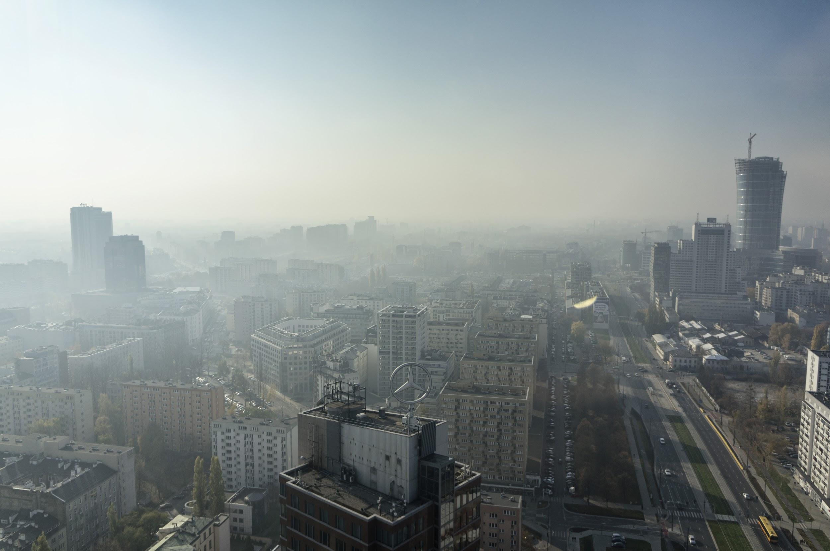
Resources
State EV Registration Data
https://www.atlasevhub.com/materials/state-ev-registration-data/#dashboard
Current California Emissions Inventory
https://ww2.arb.ca.gov/ghg-inventory-data
US EPA Explorer
https://www.epa.gov/egrid/data-explorer
Carbon Monoxide Emissions in California
https://www.kaggle.com/yoogie/carbon-monoxide-emission-in-california-19802019?select=1980.csv
Energy Consumption Database
https://ev-database.org/cheatsheet/energy-consumption-electric-car

Slide 4





Data Flow
Backend
-Web-routes
-Api Calls
Frontend
File Structure
Project 3
Static
css
Bootstrap.min.css
Styles.css
Images
Js
Analysis.js
Templates
Home.html
Analysis.html
About.html
App.py
evDB
Data Cleaning
Data Loading
Flask app

Slide 5
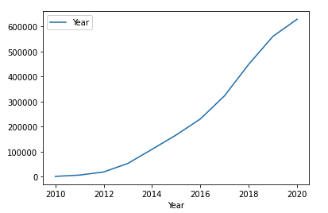
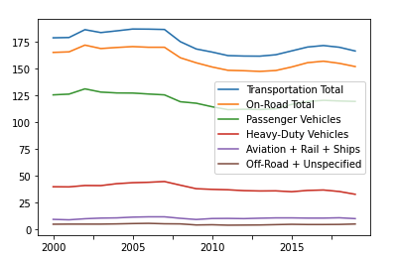
Findings
Figure 1. EV’s registrations over time
The conclusion to our analysis includes a look at the trend of Passenger Vehicle emissions in the state of California. There has been an exponential rise in the year over year registration of Electric Vehicles upon initial analysis however; it does not indicate a meaningful reduction in CO2 emission due to Passenger Vehicle emissions.
Given more time:
This in part could be due to a variety of additional factors not considered in this initial analysis, and given more time could be additional studies to include. An example of this is population characteristics, employment characteristics, policies, and more.
Figure 2. Emissions over time

Slide 6
Findings
Our EV registration data (fig1) starting in 2010 and increasing initially steadily in 2011/2012 and then exponentially in 2013 - 2020 should indicate, based on our hypothesis, a steadily decreasing trend of Passenger Vehicle Emission (fig2) over the same time period. However, the Passenger Emissions over the same period have remained relatively constant; between 111.8-119.1 MMT CO2e. There is even a slight increase in this emission category as EV’s registration increases.

Slide 7
Final Thoughts
An interesting finding is the state’s Electrics Generation Emissions over time, which should be considered given EVs are dependent on this as source of mobility.
The state’s electric grid emissions over the same period of time have decreased steadily year over year. This does lead itself to be being a more sustainable source of power versus more traditional sources.

Slide 8
Demo!!

